Slide 1
Chapter 1
A Tour of Computer System

Slide 2
Information is Bits + context
Back to the basics:
HelloWorld.c begins as a source program (source file) – human readable
#include <stdio.h>
int main( )
{
printf(“hello, world\n”);
return 0;
}
Text is represented using ascii values (0-255) each represents 8 bits or 1 byte of data per character

Slide 3
HelloWorld.c in ascii
# | i | n | c | l | u | d | e | Sp | < | s | t | d | i | o | .
35 | 105 | 110 | 99 | 108 | 117 | 100 | 101 | 32 | 60 | 115 | 116 | 100 | 105 | 111 | 46
h | > | \n | \n | i | n | t | Sp | m | a | i | n | ( | ) | \n | {
104 | 62 | 10 | 10 | 105 | 110 | 116 | 32 | 109 | 97 | 105 | 110 | 40 | 41 | 10 | 123
\n | Sp | Sp | Sp | Sp | p | r | i | n | t | f | ( | “ | h | e | l
10 | 32 | 32 | 32 | 32 | 112 | 114 | 105 | 110 | 116 | 102 | 40 | 34 | 104 | 101 | 108
l | o | , | Sp | w | o | r | l | d | \ | n | “ | ) | ; | \n | Sp
108 | 111 | 44 | 32 | 119 | 111 | 114 | 108 | 100 | 92 | 110 | 34 | 41 | 59 | 10 | 32
Sp | Sp | Sp | r | e | t | u | r | n | Sp | 0 | ; | \n | } | \n
32 | 32 | 32 | 114 | 101 | 116 | 117 | 114 | 110 | 32 | 48 | 59 | 10 | 125 | 10

Slide 4
1.1 Information is Bits + context
All information in a system is represented as bunch of binary bits
Understanding the thing that distinguishes different data is the context in which we view the data is important.
Example: A particular sequence of bytes could represent a range of different type of data. The context of the byte is what determines what it actually is.
We will learn more of this in chapter 2.

Slide 5
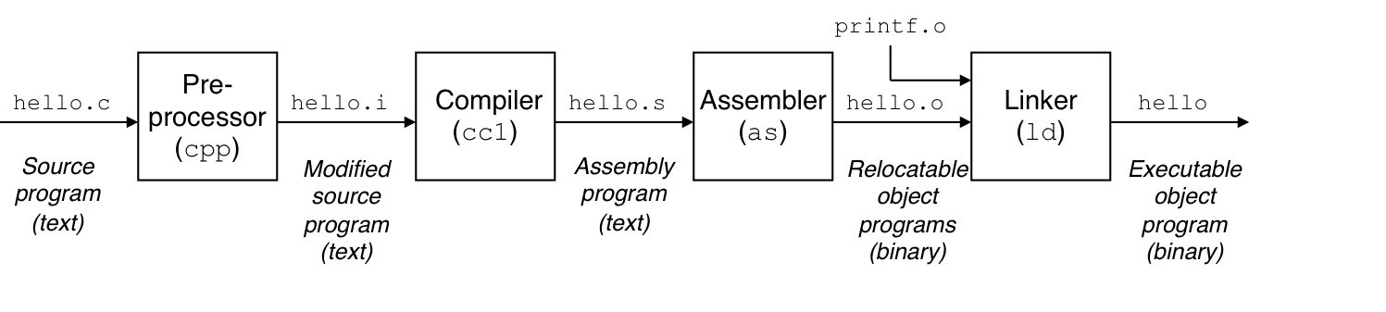
1.2 Programs are translated by other programs into different forms
4 phases to the compilation system
Pre-processing
Compilation
Assembly
Linking
We can see the files produced at each stage (gcc –save-temps hello.c –o hello)

Slide 6
Compilation system – phase 1 pre-processing
Preprocessing (cpp) phase
Modifies the original C program as per the preprocessing directives (things that start with #)
Anyone remember what a pre processing directive is?
Produces hello.i this is a text file

Slide 7
Compilation system – phase 2 compilation
Compilation (cc1) phase
Translates the text (hello.i) file into an assembly-language program
Produces a hello.s file
Each line of the assembly defines one low-level machine-language instruction in textual form
Assembly produces a common output for different compilers for different high-level languages (C and Fortran produce output in the same assembly language)

Slide 8
Compilation system – Phase 3 Assembly
Assembly (as) Phase
An assembler translates the assembly code (.s) into machine language instructions
Then packages the instructions in a form known as a relocatable object program
Stores the result in the object file in a (.o) file
Object files appear to be gibberish if opened

Slide 9
Compilation System – Phase 4 Linker
Linker (ld) Phase
When you call external functions (printf) in your program, these functions have object files that need to be merged with your program. This is what the linker does.
This phase produces the actually executable file
IMHO, errors produced from this section of the compile process is the most irritating errors to debug (other than segfaults)

Slide 10
1.3 It pays to Understand how compilation systems work
Optimizing program performance
Compilers usually produce optimal code
While we do not need to know all of the innerworkings of a compiler it is advised that you have a basic understanding of machine-level code. This understanding could help you make good programming decisions. Ex. Is a Switch better than if/else, while loop better than for loop.
Some of this material we may cover in the following chapters.
Yvon’s aside. For performance efficiency, many compilers will automatically optimize your code during the compilation process. On rare occasions, this may not be what you want it to do, such as in embedded systems.

Slide 11
1.3 It pays to Understand how compilation systems work
Understanding link-time errors
As I stated earlier linking errors are some of the most difficult compile time errors you will encounter.
They are not intuitive. Chapter 7 of this book covers more of this process.
Avoiding security holes
Having an understanding of how data and control information is stored on the program stack will help you avoid many security vulnerabilities such as buffer overflow
We will look at some of this in Chapter 3

Slide 12
1.4 Processors Read and Interpret instructions stored in MEMORY
Now that we have the program written, compiled, and an executable created, we are ready to execute it (run it)
We go to a terminal – which is basically an application shell – command-line interpreter that prints something like:
yfeaste@ada1:~ [1]
If the first argument on the command line is not some built-in shell command (ls, mkdir, rm, cd, etc.) then it assumes it is an executable and attempts to load and run the program
You should know the rest of this story

Slide 13
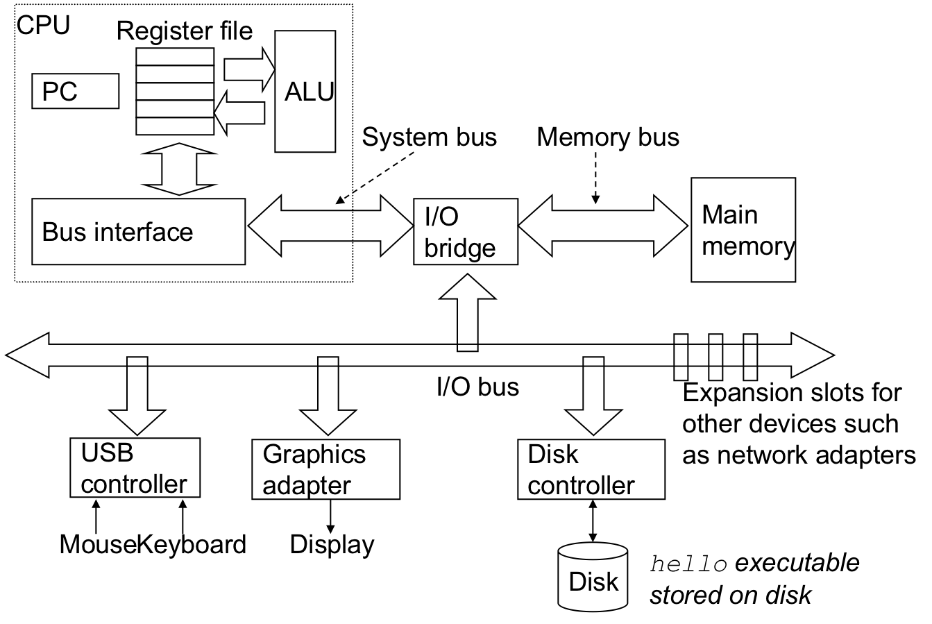
1.4.1 Hardware Organization of a system
CPU – central processing unit
ALU – arithmetic/logic unit
PC – program counter
USB – universal serial bus

Slide 14
system Buses
BUSES – Electrical conduits that carry bytes of information between components. They transfer fixed-sized chunks of bytes known as words (32bits 4 bytes or 64bits 8 bytes). The size of a word varies depending on the system. We will talk more about words later.

Slide 15
System I/O devices
I/O Devices – Input/output devices connected to the system from the outside world. This example has 4.
Mouse
Keyboard
Display
Disk drive

Slide 16
System Main memory
Main Memory - Temporary storage device that holds a program and the data it manipulates while the processor is executing the program.
Physically – main memory consist of a collection of dynamically random access memory (DRAM) chips
Logically – memory is organized as a linear array of bytes, each with its own unique address starting at 0. The size of the logically memory depends on the type of data being store. char, int, float, etc.

Slide 17
System processor
CPU – central processing unit. This is the engine that executes the instructions stored in the main memory. It has a word size register called the PC (program counter) that contains the address of some instruction in main memory.
Executes the instruction being pointed to. Upon completion the program counter moves to the next instruction in memory and repeats the process.

Slide 18
System processors
Some simple operations that the CPU might carry out at the request of an instruction:
Load – Copy a byte or word from main memory into a register, overwriting the previous content of the register
Store – Copy a byte or a word from a register to a location in main memory, overwriting the previous contents of that location
Operate – Copy the contents of two registers to the ALU, perform an arithmetic operation on the two words, and store the results in a register, overwriting the previous data
Jump – Extract a word from the instruction itself and copy that word into the PC, overwriting the previous value

Slide 19
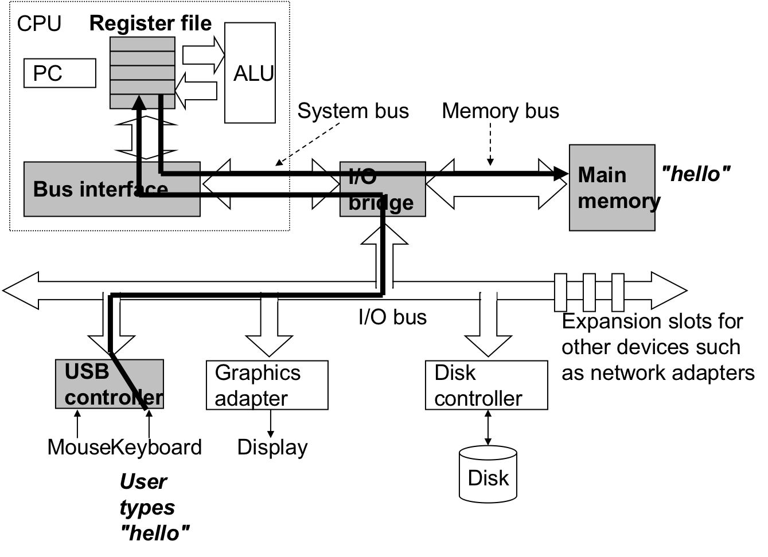
Running the hello world progRam
Now lets explore what happens when we run the hello world program:
As you type characters on the command line the characters are being read and saved in a register and then copied to main memory

Slide 20
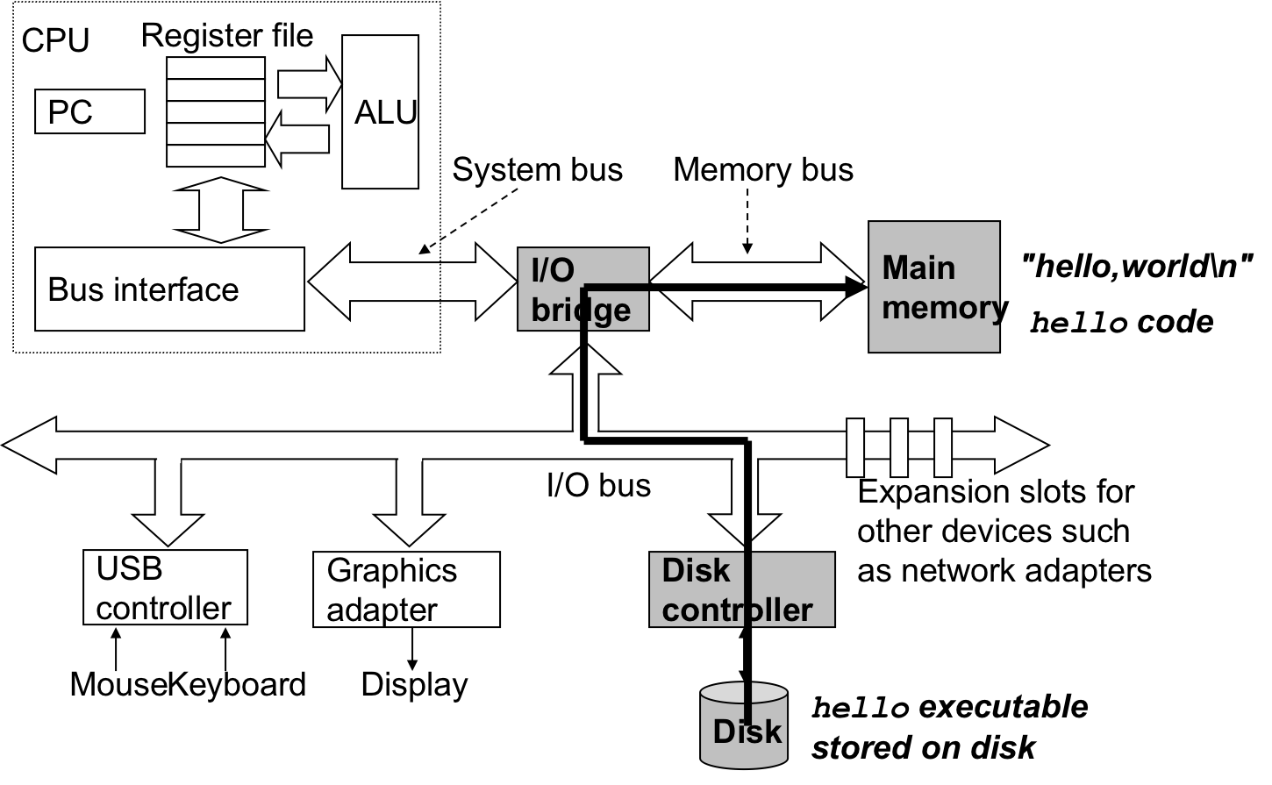
Running the hello world progRam
When we hit the enter key the shell knows we are finished defining the command. The shell then loads the executable file by coping the code and data in the hello object file that is stored on the disk to the main memory.
This step uses direct memory access (DMA) and does not need to pass through the processor.

Slide 21
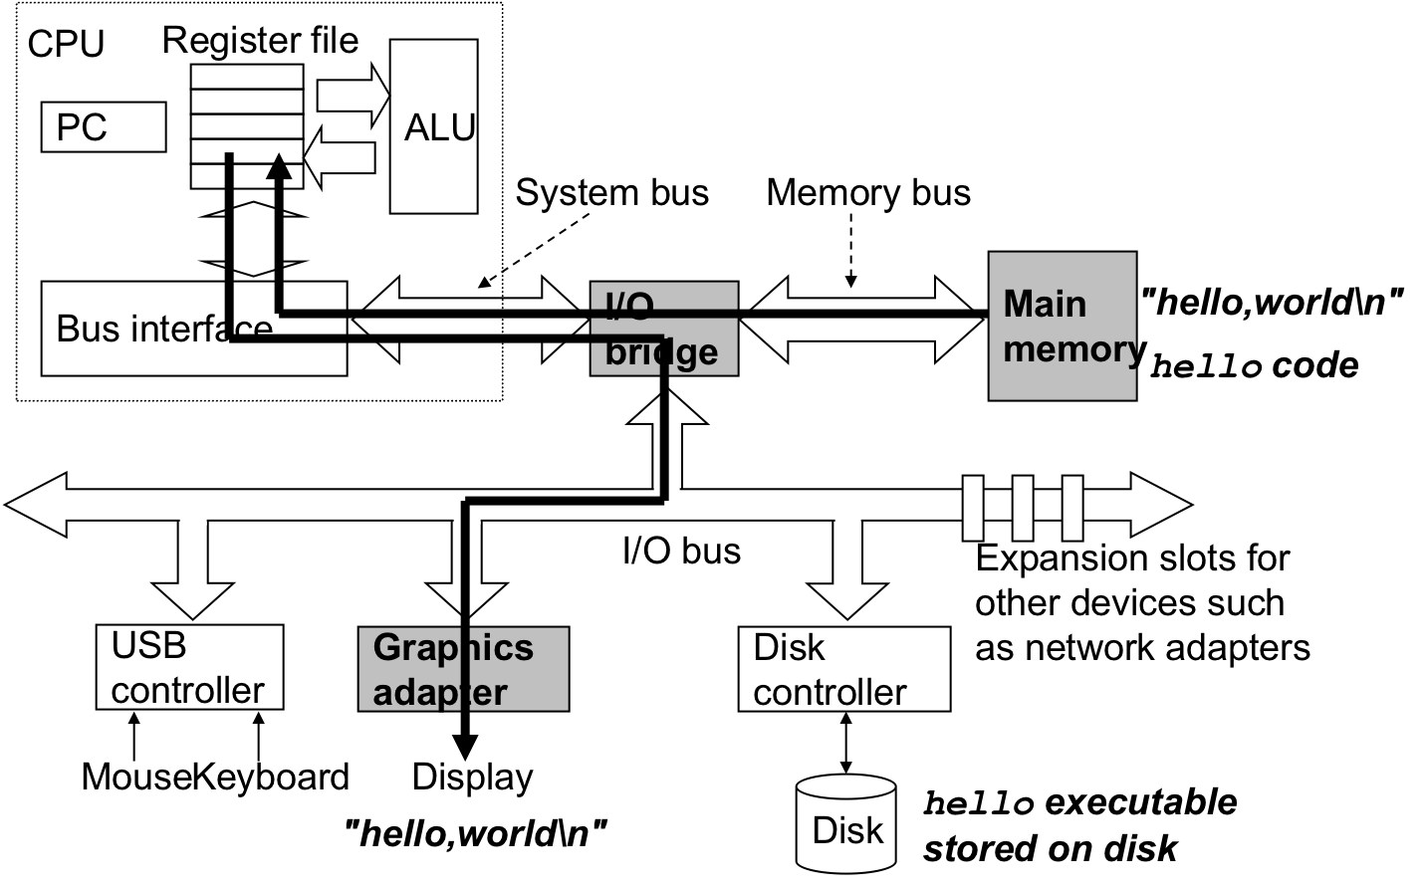
Running the hello world progRam
Once the instructions from the object file are all loaded in memory, the processor begins executing the machine-language instructions in the hello program’s main routine. In the end the hello world string is produced and copied to the registers, then sent to the output display.

Slide 22
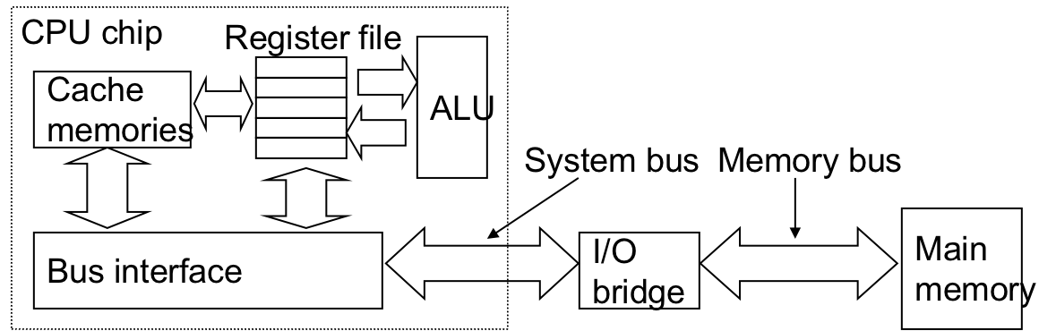
1.5 Caches Matter
As we can see from previous slides a very simple example program can spend a great deal of time moving information from one part of the computer system to another.
All of this copying is overhead that slows down the “real work” of the program.
System designers designed smaller faster storage devices called cache memories to serve as temporary staging areas for information that the processor is likely to need in the near future.

Slide 23
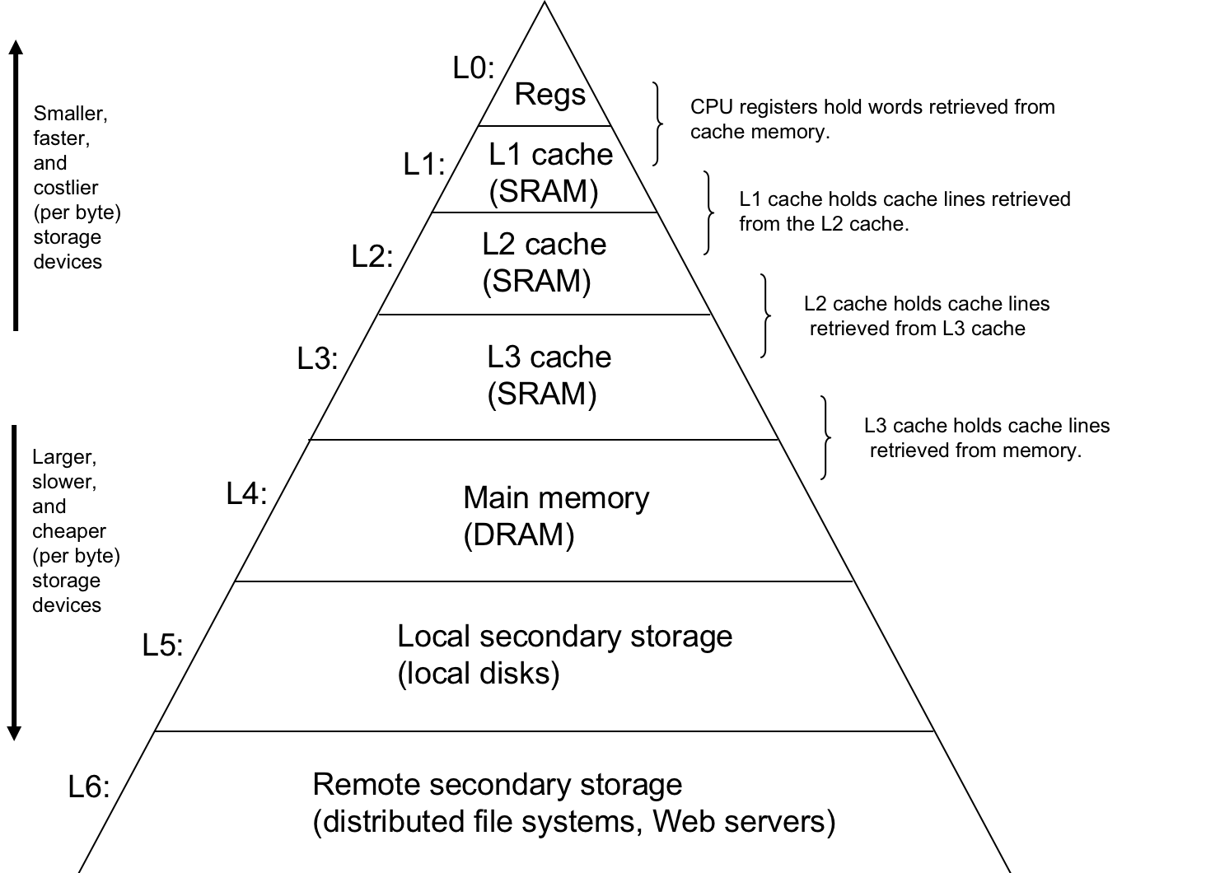
1.6 Storage Devices from a Hierarchy
As it turns out the cache philosophy of storage worked out pretty good. Storage is often set up in a hierarchy manner with smaller, faster, more expensive memory at the top and larger, cheaper, less expensive memory at the bottom. However, the main idea of memory of hierarchy being that storage at one level serves as a cache for storage to the next lower level. L0 is cache for L1, L1 and L2 are cache for L2 and L3 respectively, etc.

Slide 24
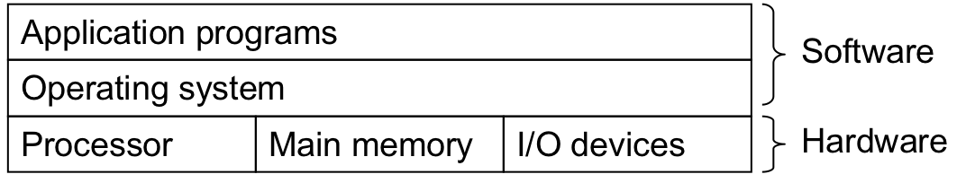
1.7 The operating system manages the hardware
All of this magic that happens between the shell program that prompted us to type a command, the moving of information from registers to main memory to the output could not happen without the help of operating system.
The OS is a layer of software interposed between the application program and the hardware as depicted above.

Slide 25
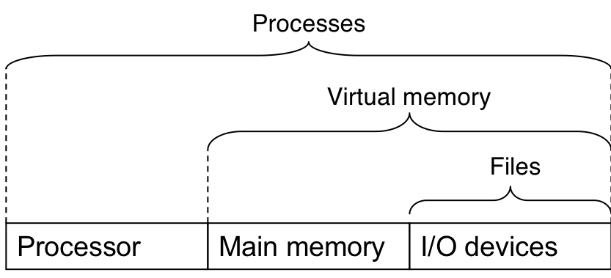
1.7 The operating system manages the hardware
The OS has 2 primary purposes
To protect the hardware from misuse by runaway applications
To provide applications with simple and uniform mechanisms for manipulating complicated and often wildly different low-level hardware devices
It achieves its goals through the abstraction of files, virtual memory, and processes

Slide 26
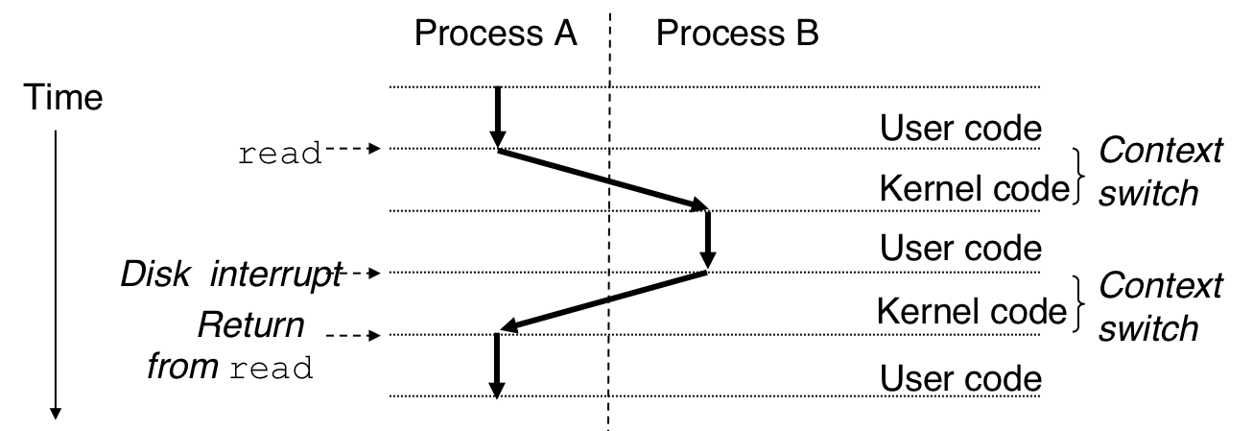
Processes
A process is the operating system’s abstraction for a running program
The system will have multiple programs running concurrently and each appears to have exclusive use of the hardware
A single CPU can appear to execute multiple processes concurrently by having the processor switch among them. This is done using context switching.
When a switch occurs, the state of that process is saved and ready to start where it left off.

Slide 27
Processes
In our hello world example we actually had two processes going on at the same time
The shell program for the terminal
The hello programs compilation and execution.

Slide 28
Threads
In most current system each process could have multiple execution units referred to as threads
Threads are crucial to network servers due to the concurrency needs
It is easier to share data through a thread than it is a process
Threads are more efficient than processes

Slide 29
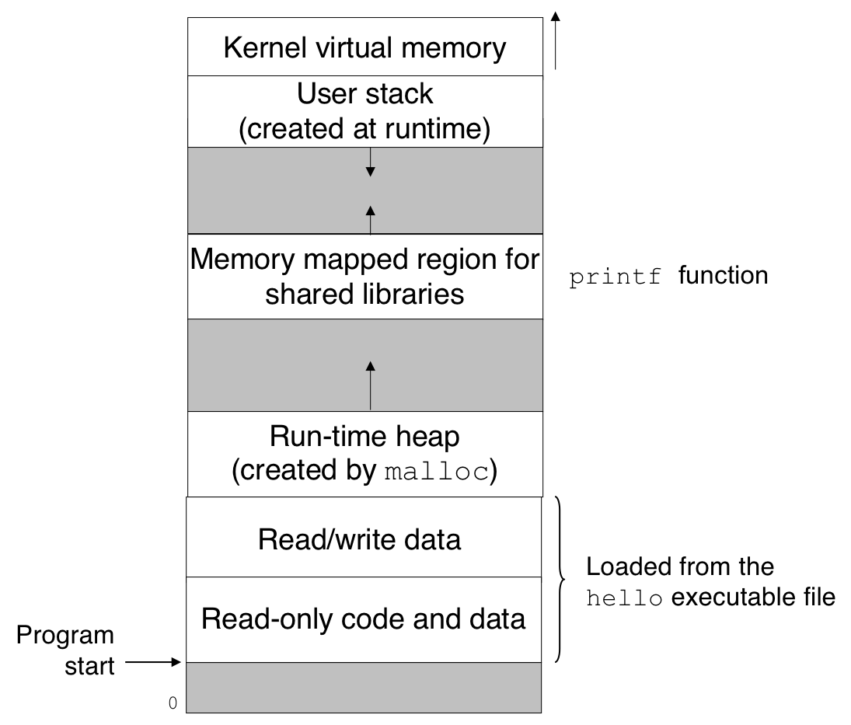
Virtual Memory
Virtual address space for Linux others are very similar
Provides each process with the illusion that it has use of the main memory
The illustration used here is the virtual address space for Linux.
Other OS virtual address space is very similar
We will learn more about this later but we will do a quick overview

Slide 30
Virtual Memory
Program code and data
Size does not change after program gets started
Heap
Grows and shrinks as needed dynamic memory
Shared libraries (stdio, stdlib, etc)
Stack
Grows and shrinks as needed
Used to implement function calls
Kernel Virtual Memory
Reserved for the OS
Virtual address space for Linux others are very similar

